Slide 1
Taiwanese Credit Card Payment Default

Slide 2
Problem Statement
Analyze the Data collected over time to predict the probability of Default for Taiwanese Credit Card Clients
Build Model to Compute probability of Default for Taiwanese Credit Card Clients
Classification Problem

Slide 3
Data Set details
This Multivariate dataset is made up of 30K transactions with 24 Attributes
Overall 22.1% transaction values are default and 77.88% are not default.
Categoric features: 'SEX', 'EDUCATION', 'MARRIAGE', 'PAY_0', 'PAY_2', 'PAY_3', 'PAY_4', 'PAY_5', 'PAY_6’
Numeric features: 'LIMIT_BAL', 'AGE', 'BILL_AMT1', 'BILL_AMT2', 'BILL_AMT3', 'BILL_AMT4', 'BILL_AMT5', 'BILL_AMT6', 'PAY_AMT1', 'PAY_AMT2', 'PAY_AMT3', 'PAY_AMT4', 'PAY_AMT5', 'PAY_AMT6’
Target Variable: 'default payment next month’.
No Null values in any of 24 attributes provided.

Slide 4
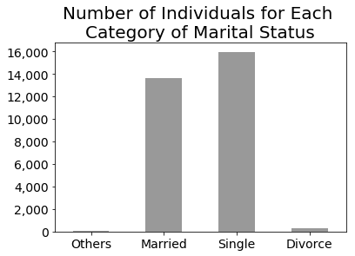
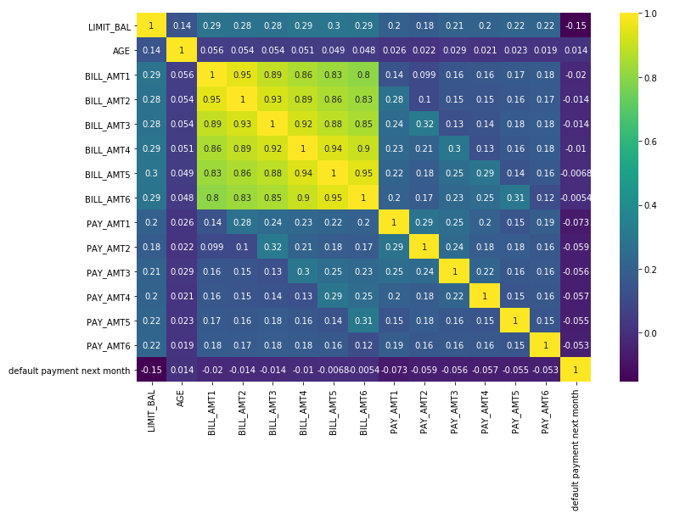
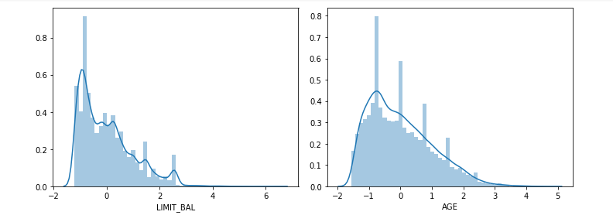
Exploratory Data Analysis
Numeric features are analyzed with correlation heat map.
For categorical variable we used cross tab and plots.
For Skewness we plotted distplot to see distribution.

Slide 5
Pre-processing and Cleaning
Categorical features ‘MARRIAGE’ and ‘EDUCATION’ had extra undefined labels which we cleaned by merging to defined labels.
Distplot showed numeric data is skewed . We added log transformation and scaling to bring data as close to normal distribution
Included One hot encoding on categorical features ‘SEX’ ‘MARRIAGE’ and ‘EDUCATION’ to bring then on one scale. Increased 3 columns here.
Analyzed Correlation for numeric data and found 6 bill amt fields are highly correlated among themselves, we created new ratio as BILL_AMT-PAY_AMT/LIMIT_AMT which is less correlated and dropped BILL AMT columns.
Finalized on 27 attributes to work on.

Slide 6
LOGISTIC REGRESSION
Data Set/Description | Train | Dev | Test/Prod
Accuracy Score | 0.8213 | 0.814167 | 0.81134
Confusion Matrix | [[12511 536][ 2466 1287]] | [[5359 280] [1058 503]] | [[4442 236] [ 896 426]]
Support | 16800 | 7200 | 6000
AUC | 0.6509 | .636 | 0. 635
Precision | 0.81 | 0.79 | 0.79
Recall | 0.82 | 0.81 | 0.81
F1 Score | 0.80 | 0.79 | 0.79

Slide 7
Random Forest
Data Set/Description | Train | Dev | Test/Prod
Accuracy Score | 0.95 | 0.81 | 0.804
Confusion Matrix | [[12941 106] [ 734 3019]] | [[5248 391] [ 974 587]] | [[4354 324] [ 848 474]]
Support | 16800 | 7200 | 6000
AUC | 0.898 | 0.65 | 0.64
Precision | 0.95 | 0.79 | 0.78
Recall | 0.95 | 0.81 | 0.80
F1 Score | 0.95 | 0.79 | 0.79

Slide 8
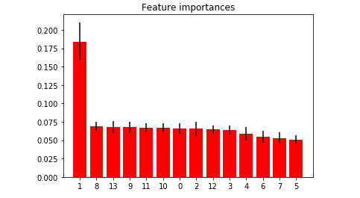
Random Forest with Feature selection and Parameter Tuning as GridSearch
1. Analyzed Correlation for numeric data and found 6 BILL_AMT fields are highly correlated among themselves, we created new ratio as BILL_AMT-PAY_AMT/LIMIT_AMT which is less correlated and dropped BILL AMT columns.
2.By using selectFromModel we identified 14 important features to build model on.
Final features:
'AGE', 'PAY_0', 'PAY_AMT1', 'PAY_AMT2', 'PAY_AMT3', 'PAY_AMT4', 'PAY_AMT5', 'PAY_AMT6’, ‘Cal_Ratio1', ' Cal_Ratio1 2', ' Cal_Ratio1 3', ' Cal_Ratio1 4', ' Cal_Ratio1 5', ' Cal_Ratio1 6’
Best estimator predicted by Gridsearch
{'criterion': 'gini','max_depth': 6,'max_features': 'log2','min_samples_leaf': 2,'min_samples_split': 2,'n_estimators': 4}

Slide 9
Random Forest with FS along with PT
Data Set/Description | Train | Dev | Test/Prod
Accuracy Score | 0.817 | 0.816 | 0.815
Confusion Matrix | [[12611 432] [ 2636 1121]] | [[5417 199] [1123 461]] | [[4522 183] [ 925 370]]
Support | 16800 | 7200 | 6000
AUC | 0.63 | 0.62 | 0.623
Precision | 0.80 | 0.80 | 0.80
Recall | 0.82 | 0.82 | 0.82
F1 Score | 0.79 | 0.79 | 0.79

Slide 10
XGBoost with parameter tuning
Parameter finalized:
xgb4 = XGBClassifier(learning_rate =0.01,n_estimators=1000,max_depth=3,min_child_weight=12,gamma=0.2,subsample=0.8,colsample_bytree=0.8,reg_alpha=0.01,objective= 'binary:logistic',nthread=4,scale_pos_weight=1,seed=27)
Feature Importance

Slide 11
XGBoost with Parameter Tuning
Data Set/Description | Train | Dev | Test/Prod
Accuracy Score | .8287 | .8187 | .8143
Confusion Matrix | [[12522,562] [2316,1400]] | [[5341,271] [1034,554]] | [[4416,252] [862,470]]
Support | 16800 | 7200 | 6000
AUC | .7985 | .7798 | .7755
Precision | .82 | .80 | .80
Recall | .83 | .82 | .81
F1 Score | .81 | .80 | .79

Slide 12
Conclusion
XGBoost model opted as final approach with parameter tuning.
Future Approach
Over Sampling and Under Sampling can be implemented in future.
Would like to make visualization much better.
Can try other models with parameter tuning.
Link to GitHub::https://github.com/HardikaB/Hackathon1

